Slide 1

Overview of OOP and Java
Mr. Nilesh B. Ghavate Technical Trainer
B.TECH CSE AIDS Department

Slide 2
Lesson Plan
Subject/Course | Java Programming
Lesson Title | Overview of OOP and Java
Lesson Objectives
Programming Paradigms
OOP Features
JVM Architecture, JRE, JDK,
Java Environment Setup

Slide 3
Outline
Programming Paradigms
Procedural vs Object-Oriented Programming
OOP Features
History of Java
Feature of Java
JVM Architecture
JRE, JDK
Java Program Structure
Compilation and Execution Process
Java Environment Setup
JDK Installation
Introduction to IDEs.

Slide 4
Programming Paradigms
What is a Programming Paradigm?
A programming paradigm is a fundamental method of building and organizing computer programs.
It defines how programs are structured and organized.
Different paradigms solve problems in different ways.
Java supports multiple programming paradigms, Because it supports more than one programming style.

Slide 5
Types of Programming Paradigms
Procedural-Oriented Programming
Object-Oriented Programming (OOP)
Functional Programming
Event-Driven Programming

Slide 6
Difference Between Procedural and Object-Oriented Programming
Feature | Procedural Programming | Object-Oriented Programming (OOP)
Focus | Functions and procedures | Objects and classes
Approach | Top-down approach | Bottom-up approach
Data Handling | Data and functions are separate | Data and methods are combined into objects
Security | Less secure | More secure through encapsulation
Code Reusability | Limited | High through inheritance and polymorphism
Maintenance | Difficult for large programs | Easier for large programs
Problem Solving | Step-by-step instructions | Real-world object modeling
Examples | C, Pascal, BASIC | Java, C++, C#, Python

Slide 7
Difference Between Functional Programming and Event-Driven Programming
Feature | Functional Programming | Event-Driven Programming
Focus | Functions and data transformation | Events and event handlers
Execution Style | Executes by calling functions | Executes when an event occurs
Data Handling | Uses immutable data (data doesn't change) | Data changes based on user/system events
Control Flow | Determined by function calls | Determined by events such as clicks, inputs, messages
State Management | Avoids shared state | Often maintains application state
Best For | Data processing, calculations, parallel computing | GUI applications, web apps, mobile apps
Code Reusability | High due to pure functions | Depends on event handlers
Examples in Java | Lambda Expressions, Stream API | Swing, JavaFX, AWT
Real-World Analogy | Mathematical calculations | Doorbell or traffic signal system
Programming Languages | Haskell, Scala, Lisp, Java | Java, JavaScript, C#, Python

Slide 8
OOP Features in Java
Object-Oriented Programming (OOP)
OOP is a programming paradigm based on Objects and Classes.
It models real-world entities in software.
Java is primarily an Object-Oriented Programming language.
Benefits
Code Reusability
Data Security
Easy Maintenance
Real-World Modeling

Slide 9
OOP Features in Java
Object-Oriented Programming (OOP)
OOP is a programming paradigm based on Objects and Classes.
It models real-world entities in software.
Java is primarily an Object-Oriented Programming language.
Benefits
Code Reusability
Data Security
Easy Maintenance
Real-World Modeling

Slide 10
class CodeReusability
{
int add(int a, int b)
{
return a + b;
}
int subtract(int a, int b)
{
return a - b;
}
}
public class CodeReu {
public static void main(String[] args) {
CodeReusability obj = new CodeReusability();
System.out.println("Addition = " + obj.add(10, 5));
System.out.println("Subtraction = " + obj.subtract(10, 5));
}
}
OOP Features in Java

Slide 11
Main Features of OOP
Four Pillars of OOP
Encapsulation
Inheritance
Polymorphism
Abstraction
These four concepts form the foundation of Object-Oriented Programming.

Slide 12
Encapsulation
Definition
Encapsulation is the process of binding data (variables) and methods together into a single unit (class).
Features
Data hiding
Improved security
Controlled access using getters and setters
Real-Life Example
Bank Account
Account balance is private.
Access is provided through deposit() and withdraw() methods.

Slide 13
Example
class Student {
private int age;
public void setAge(int age) {
this.age = age;
}
public int getAge() {
return age;
}
}

Slide 14
Inheritance
Definition
Inheritance allows one class to acquire properties and methods of another class.
Features
Code reusability
Reduces duplication
Creates parent-child relationship
Real-Life Example
Vehicle → Car
Vehicle has common properties.
Car inherits those properties

Slide 15
Example
class Vehicle {
void start() {
System.out.println("Vehicle Started");
}
}
class Car extends Vehicle {
}

Slide 16
Polymorphism
Definition
Polymorphism means "Many Forms".
The same method can perform different actions.
Types
Compile-Time Polymorphism (Method Overloading OR Early Binding)
Run-Time Polymorphism (Method Overriding OR Late Binding)
Real-Life Example
Smartphone
One device performs multiple functions:
Calling
Camera
Internet
Music

Slide 17
Example
class MathOperation {
int add(int a, int b) {
return a + b;
}
int add(int a, int b, int c) {
return a + b + c;
}
}

Slide 18
Abstraction
Definition
Abstraction hides implementation details and shows only essential information.
Features
Reduces complexity
Improves security
Focuses on what an object does instead of how it does it
Real-Life Example
Car Driving
Driver uses:
Steering
Brake
Accelerator
The internal engine mechanism is hidden.

Slide 19
Example:
abstract class Vehicle {
abstract void start();
}
class Car extends Vehicle {
void start() {
System.out.println("Car Started");
}
}

Slide 20
History of Java
Java is a high-level, object-oriented, platform-independent programming language.
Developed to create software that can run on different devices and operating systems.
Why Was Java Developed?
Existing languages were platform-dependent.
Need for a language that could run on multiple platforms.
Based on the concept:
"Write Once, Run Anywhere (WORA)"
Java programs can run on any system with a Java Virtual Machine (JVM).
Who Developed Java?
James Gosling (Father of Java)
Developed at Sun Microsystems with:
Mike Sheridan
Patrick Naughton

Slide 21
Java Versions and Evolution
Year | Event
1991 | Project Green started
1991 | Language named Oak
1995 | Renamed to Java
1996 | Java 1.0 released
2010 | Sun Microsystems acquired by Oracle
16th Sept 2025 | Java 25 (Latest [LTS] Long-Term SupportVersion)

Slide 22
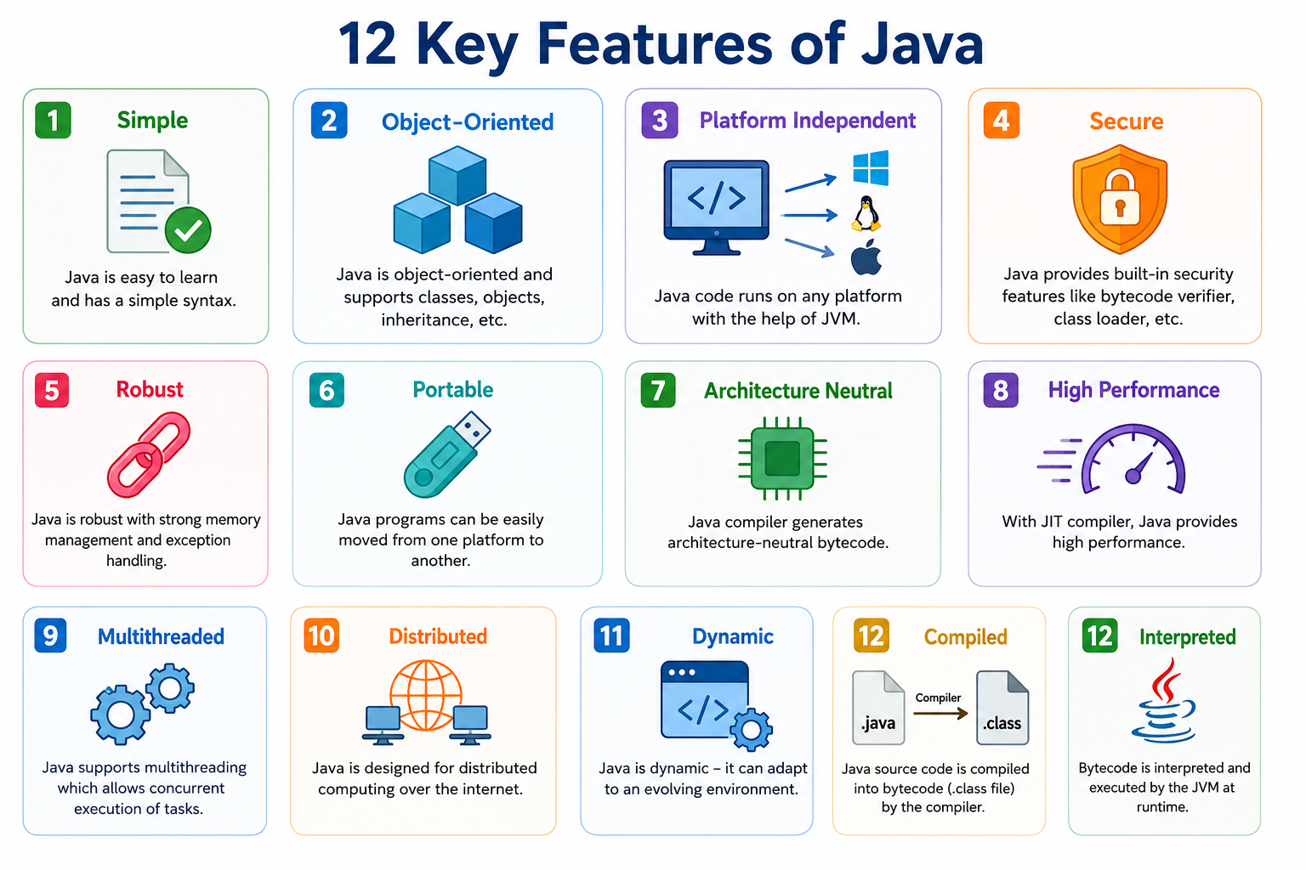
Features of Java

Slide 23
Features of Java
1. Simple
Java has a simple and easy-to-learn syntax.
Similar to C and C++ but removes complex features like pointers and operator overloading.
Easy for beginners to understand and use.
Benefit:
Faster learning and development.

Slide 24
Features of Java
2. Object-Oriented
Java is based on classes and objects.
Supports:
Encapsulation
Inheritance
Polymorphism
Abstraction
Benefit:
Better code organization and reusability.
Example:
Real-world entities like Student, Car, and Bank Account can be modeled as objects.

Slide 25
Features of Java
3. Platform Independent
Java follows the principle:
"Write Once, Run Anywhere (WORA)"
Java source code is converted into Bytecode.
Bytecode runs on any system with a JVM.
Benefit:
Same program works on Windows, Linux, and macOS without modification.

Slide 26
Features of Java
4. Secure
Java provides built-in security features.
No direct memory access through pointers.
JVM checks code before execution.
Security Features:
Bytecode Verification
Class Loader
Security Manager
Benefit:
Protection from malicious code and viruses.

Slide 27
Features of Java
5. Robust
Java is designed to minimize errors.
Strong memory management.
Automatic Garbage Collection.
Exception Handling mechanism.
Benefit:
Reliable and stable applications.

Slide 28
Features of Java
6. Portable
Java programs can be moved easily between platforms.
Consistent data types across all systems.
Benefit:
Easy software migration.
7. Architecture Neutral
Java Bytecode is not dependent on processor architecture.
Works on any hardware architecture.
Benefit:
Hardware-independent execution.

Slide 29
Features of Java
8. High Performance
Java uses Just-In-Time (JIT) Compiler.
Frequently used code is converted into machine code.
Benefit:
Faster execution compared to traditional interpreted languages.
9. Multithreaded
Java supports multiple threads running simultaneously.
Allows execution of multiple tasks at the same time.
Example:
Downloading a file while browsing a webpage.
Benefit:
Better CPU utilization and performance.

Slide 30
Features of Java
Distributed
Java supports distributed applications.
Provides networking APIs for communication between systems.
Examples:
Client-Server Applications
Web Applications
Benefit:
Easy development of network-based applications.

Slide 31
Features of Java
11. Dynamic
Java can load classes dynamically during runtime.
Supports runtime linking.
Benefit:
Greater flexibility and adaptability.
12. Compiled and Interpreted
Java is both a Compiled and an Interpreted language.
The Java Compiler (javac) converts source code (.java) into Bytecode (.class).
The Java Virtual Machine (JVM) interprets or JIT-compiles the Bytecode and executes it.
This approach provides platform independence and better performance.

Slide 32
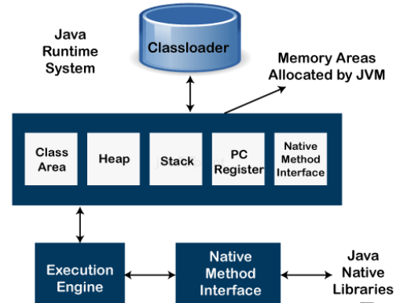
JVM Architecture

Slide 33
JVM Architecture
The Java Runtime System is responsible for executing Java applications. It consists of the Class Loader, Runtime Memory Areas, Execution Engine, and Native Method Interface (JNI). Together, these components enable Java's platform-independent execution.
1. Class Loader
Loads Java class files (.class) into memory.
Dynamically loads classes when they are required.
Performs:
Loading – Reads class files.
Linking – Verifies and prepares classes.
Initialization – Assigns values to static variables.
Acts as the bridge between compiled Java code and JVM execution.

Slide 34
JVM Architecture
Class Area (Method Area)
Stores class metadata, method information, and static variables.
Shared among all threads.
2. JVM Memory Areas
Heap Memory
Stores objects and instance variables.
Largest memory area in JVM.
Managed by the Garbage Collector.
Stack Memory
Stores method calls, local variables, and partial results.
Each thread has its own stack.
Memory is released automatically after method execution.
Native Method Stack
Supports execution of native methods written in languages like C or C++.
Works through JNI (Java Native Interface).
Program Counter (PC) Register
Keeps track of the current instruction being executed.
Each thread has its own PC register.

Slide 35
JVM Architecture
3. Execution Engine
Executes the bytecode loaded into memory.
Components:
Interpreter – Executes bytecode line by line.
JIT (Just-In-Time) Compiler – Converts frequently used bytecode into machine code for faster execution.
Garbage Collector – Removes unused objects and frees memory.

Slide 36
JVM Architecture
4. Native Method Interface (JNI)
Allows Java applications to interact with native code.
Provides communication between Java and external libraries.
Used when platform-specific functionality is required.
5. Java Native Libraries
Libraries written in languages such as C/C++.
Accessed through JNI.
Enable integration with operating system features and hardware resources.

Slide 37
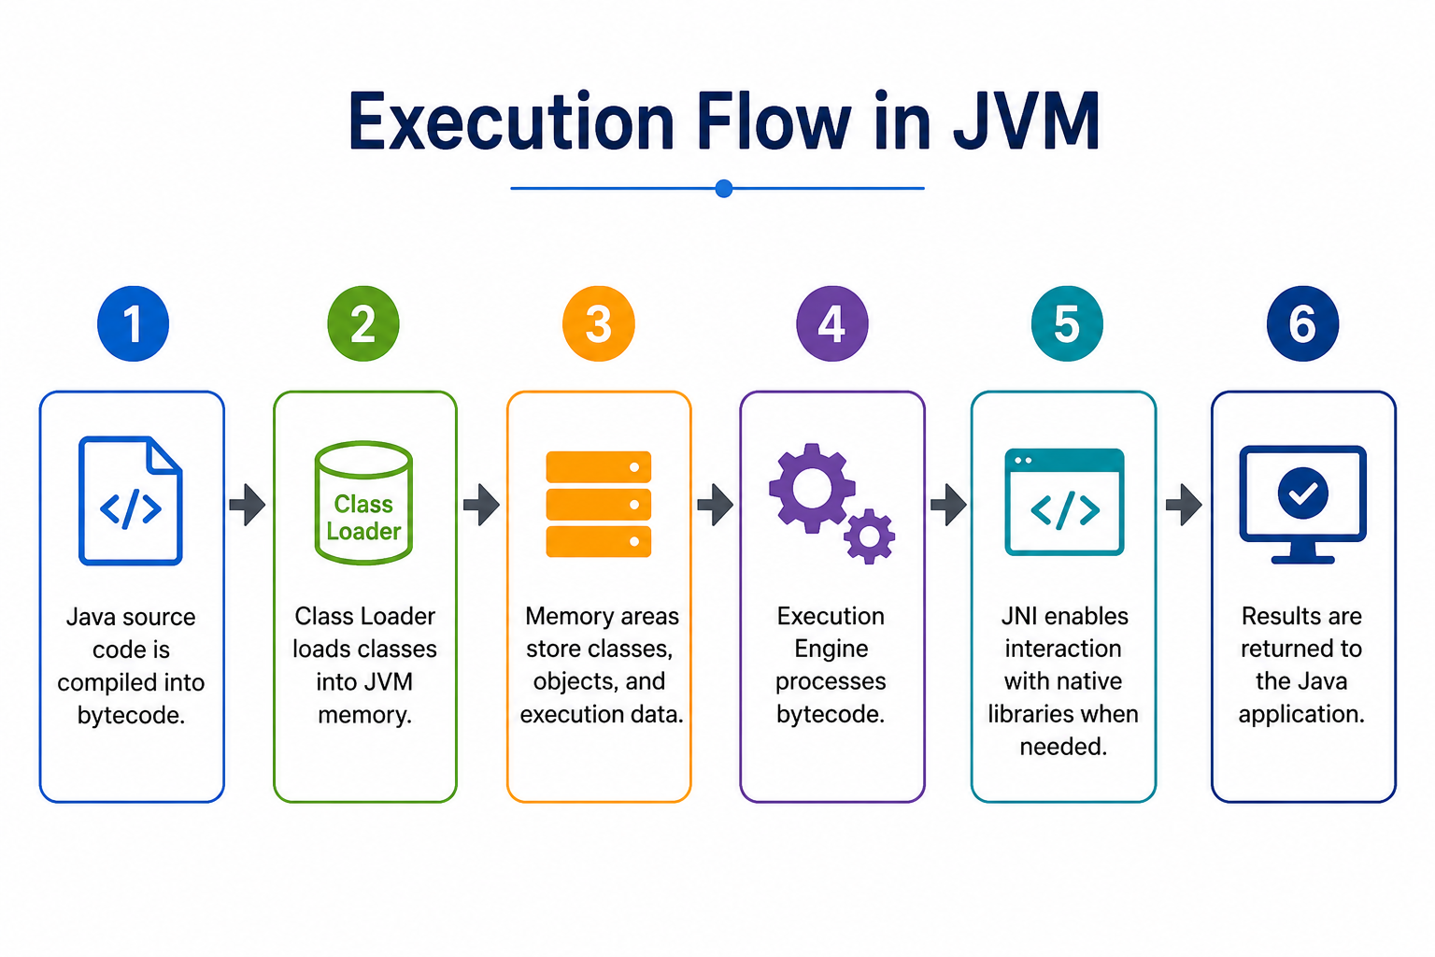
JVM Architecture

Slide 38
JRE
What is JRE?
Java Runtime Environment (JRE)
JRE stands for Java Runtime Environment.
It provides the environment required to run Java applications.
Contains:
JVM (Java Virtual Machine)
Core Java Libraries
Supporting Files
Does not include development tools like compiler (javac).
Formula:
JRE = JVM + Java Libraries + Supporting Files

Slide 39
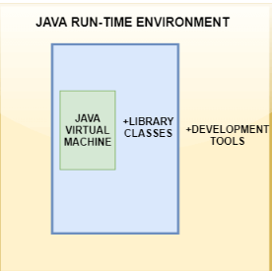
JRE
How does JRE work with JVM?

Slide 40
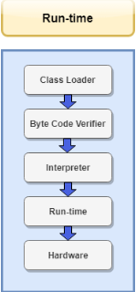
JRE
How does JRE work with JVM?
Relationship Between JRE and JVM
JRE (Java Runtime Environment) provides the complete environment required to run Java applications.
JVM (Java Virtual Machine) is a component inside the JRE responsible for executing Java bytecode.
JRE supplies the JVM with:
Java Class Libraries
Runtime Resources
Configuration Files
Simple Formula
JRE = JVM + Java Libraries + Supporting Files

Slide 41
JDK
Java Development Kit (JDK)
JDK stands for Java Development Kit.
It is a software package used to develop, compile, debug, and run Java applications.
Provides all the tools required for Java development.
Developed and maintained by Oracle.
Formula
JDK = JRE + Development Tools

Slide 42
JDK
Main Components of JDK
1. JVM (Java Virtual Machine)
Executes Java bytecode.
Provides platform independence.
2. JRE (Java Runtime Environment)
Runtime environment for Java applications.
Contains JVM and Java libraries.
3. Development Tools
Compiler (javac)
Java Launcher (java)
Debugger (jdb)
Documentation Generator (javadoc)
Archiver (jar)

Slide 43
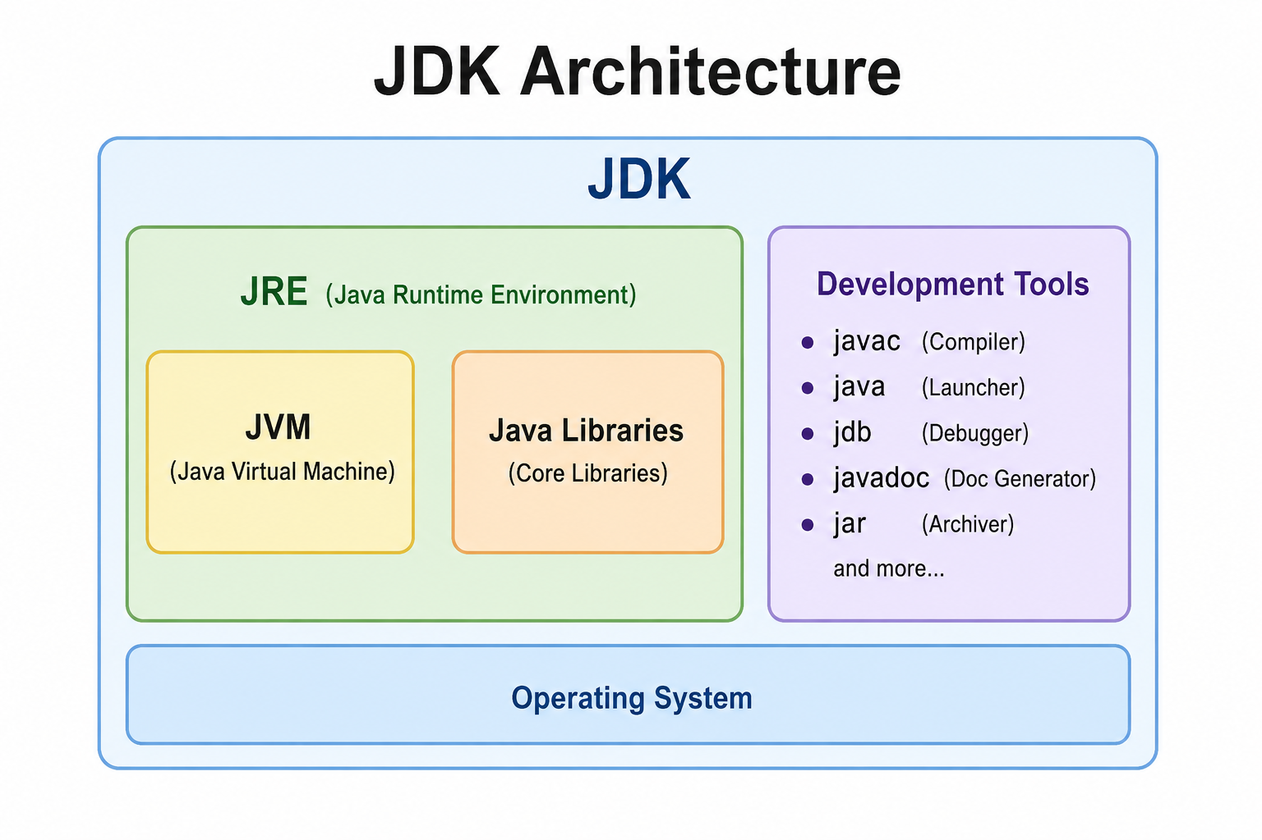
JDK

Slide 44
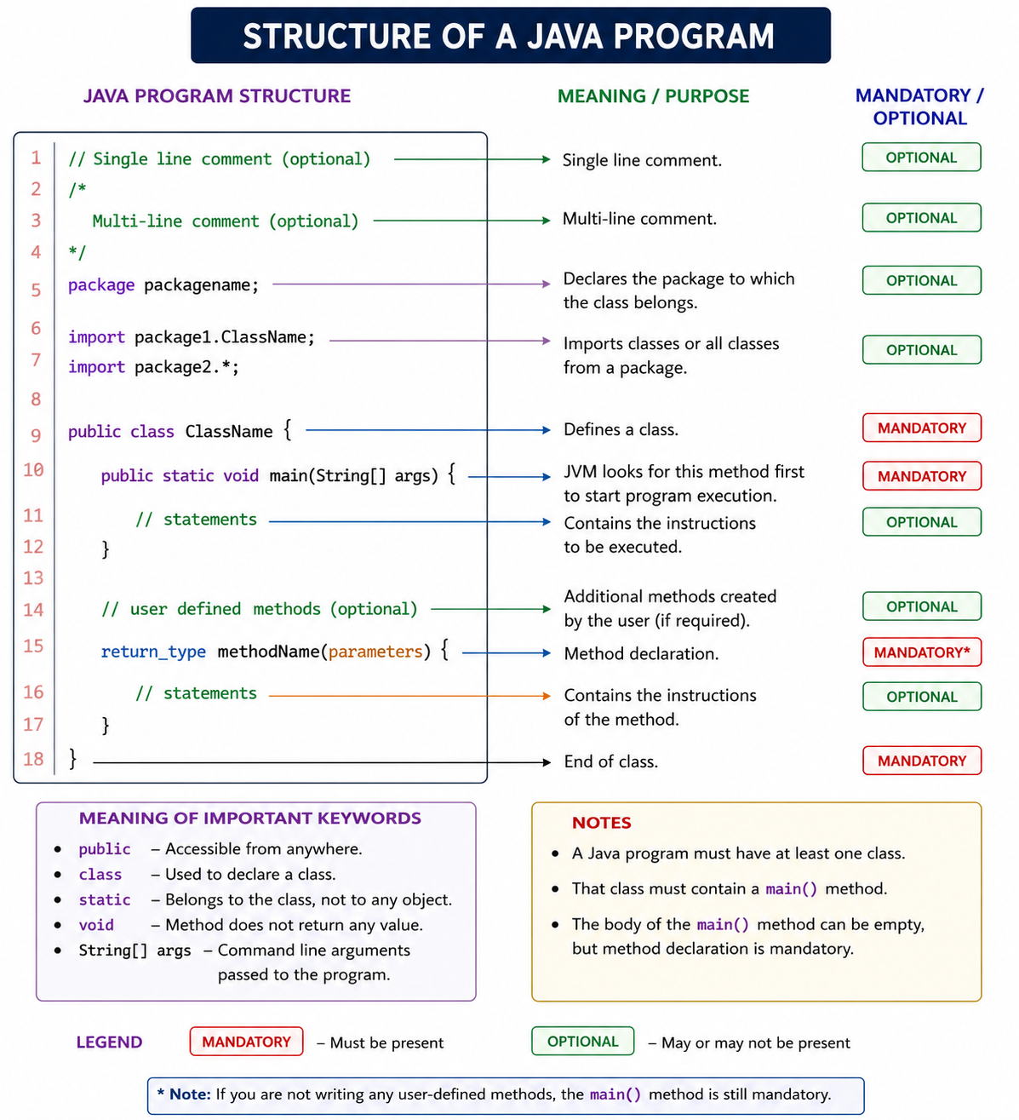

Slide 45
Compilation & Execution Process
What is Java Compilation and Execution?
Java is a platform-independent programming language.
Java follows the principle: "Write Once, Run Anywhere (WORA)".
Source code is converted into Bytecode, which can run on any system having a Java Virtual Machine (JVM).

Slide 46
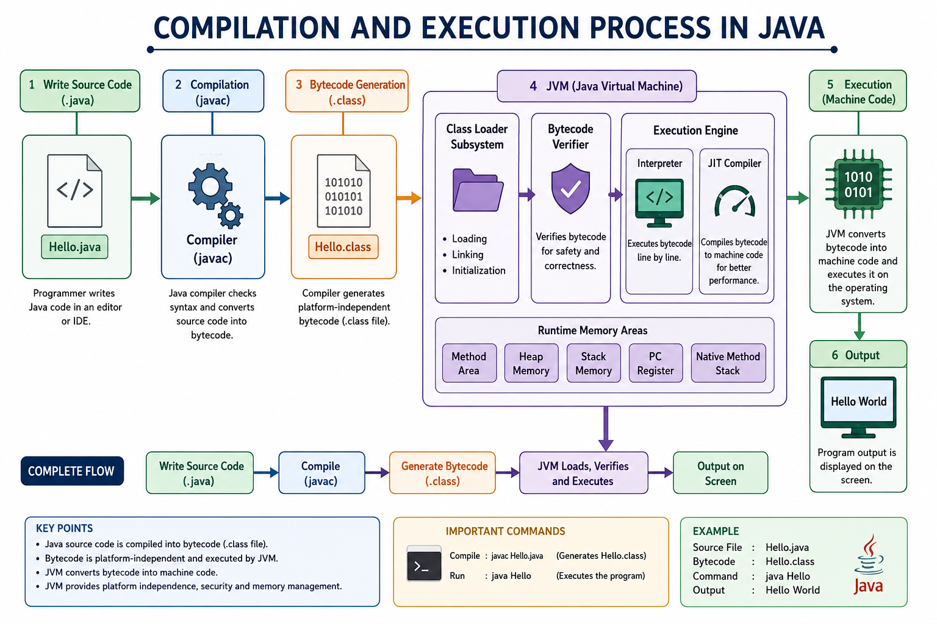

Slide 47
Compilation & Execution Process
Writing Source Code
Java Source File
Programmer writes code in a text editor or IDE.
File extension: .java
Example:
class Hello { public static void main(String[] args) { System.out.println("Hello World"); } }

Slide 48
Compilation & Execution Process
Compilation Process
Java Compiler (javac)
The Java Compiler translates source code into bytecode.
Command:
javac Hello.java
Output:
Hello.class
Functions of Compiler
Syntax checking
Error detection
Bytecode generation

Slide 49
Compilation & Execution Process
Bytecode
What is Bytecode?
Intermediate code generated by the compiler.
Stored in .class files.
Platform-independent.
Can run on any system with JVM.
Advantages
Portability
Security
Easy distribution

Slide 50
Compilation & Execution Process
JVM (Java Virtual Machine)
Role of JVM
Executes Java Bytecode.
Converts bytecode into machine-specific instructions.
Provides platform independence.
JVM Components
Class Loader
Bytecode Verifier
Runtime Memory Areas
Execution Engine

Slide 51
Compilation & Execution Process
Compilation & Execution Process
Class Loader
Class Loader Subsystem
Loads .class files into memory.
Dynamically loads classes when needed.
Responsibilities
Loading
Linking
Initialization

Slide 52
Compilation & Execution Process
Bytecode Verification
Bytecode Verifier
Checks bytecode before execution.
Ensures:
Code safety
Memory access correctness
No illegal operations
Benefits
Improves security
Prevents malicious code execution

Slide 53
Compilation & Execution Process
Execution Engine
Execution Engine
Responsible for executing bytecode.
Components:
Interpreter
Executes bytecode line by line.
Slower execution.
JIT (Just-In-Time) Compiler
Converts bytecode into machine code.
Improves performance.

Slide 54
Compilation & Execution Process
Runtime Memory Areas
JVM Memory Structure
Method Area
Heap Memory
Stack Memory
PC Register
Native Method Stack
Purpose
Stores classes, objects, variables, and execution information.

Slide 55
Compilation & Execution Process
Execution Process Example
Commands
Compile:
javac Hello.java
Run:
java Hello
Output:
Hello World

Slide 56
Compilation & Execution Process
Advantages of Java Compilation Process
Benefits
Platform Independence
Enhanced Security
Better Performance with JIT
Automatic Memory Management
Robust Error Checking

Slide 57
Java Environment Setup
What is Java Environment Setup?
Java Environment Setup is the process of installing and configuring Java tools required for developing and running Java applications.
Components of Java
JDK (Java Development Kit) – Development tools and compiler.
JRE (Java Runtime Environment) – Runs Java applications.
JVM (Java Virtual Machine) – Executes Java bytecode.
Download JDK
https://www.oracle.com/java/technologies/downloads/
https://openjdk.org/

Slide 58
Java Environment Setup
JDK Installation
Steps to Install JDK
1. Download JDK
Oracle JDK: www.oracle.com/java/technologies/downloads/
OpenJDK: www.openjdk.org
2. Install JDK
Run the installer.
Select installation directory.
Complete the installation process.
3. Verify Installation
Open Command Prompt and type:
java -version javac -version
Successful installation displays the installed Java version.

Slide 59
Java Environment Setup
Steps to Set Up Java Environment
1. Install JDK
Download and install the latest JDK version.
2. Configure Environment Variables
Set JAVA_HOME to the JDK installation directory.
Add %JAVA_HOME%\bin to the PATH variable.
3. Verify Installation
java -version javac -version
4. Write and Run a Java Program
Compile:
javac Hello.java
Run:
java Hello

Slide 60
PATH and CLASSPATH
PATH Variable
Specifies the location of Java executable files.
Allows Java commands to run from any directory.
Example:
C:\Program Files\Java\jdk-21\bin
CLASSPATH Variable
Specifies the location of Java class files and libraries.
Helps JVM locate required classes during execution.
Example:
.;C:\Java\Libraries\
Benefits
✔ Easy command execution
✔ Access to external libraries
✔ Proper program execution

Slide 61
Introduction to IDEs
What is an IDE?
An Integrated Development Environment (IDE) provides tools for coding, debugging, compiling, and testing Java programs.
IDE | Website
Eclipse | www.eclipse.org
IntelliJ IDEA | www.jetbrains.com/idea
Apache NetBeans | www.netbeans.apache.org
Visual Studio Code | www.code.visualstudio.com

Slide 62
Introduction to IDE’s
Advantages of IDEs
Code Completion
Syntax Highlighting
Error Detection
Debugging Support
Project Management

